Slide 1
Outline
Introduction
Background
Distributed DBMS Architecture
Distributed Database Design
Distributed Query Processing
Distributed Transaction Management
Building Distributed Database Systems (RAID)
Mobile Database Systems
Privacy, Trust, and Authentication
Peer to Peer Systems

Slide 2
Useful References
E. Pitoura and B. Bhargava, Data Consistency in Intermittently Connected Distributed Systems, IEEE TKDE, 11(6), 1999.
E. Pitoura and G. Samaras, Data Management for Mobile Computing, Kluwer Academic Publishers, 1998.
S. Bhowmick, S. Madria, and W. K. Ng, Web Data Management: A Warehouse Approach, Springer, 2003.

Slide 3
What is Pervasive Computing?
“Pervasive computing is a term for the strongly emerging trend toward:
– Numerous, casually accessible, often invisible computing devices
– Frequently mobile or embedded in the environment
– Connected to an increasingly ubiquitous network structure.”
– NIST, Pervasive Computing 2001

Slide 4
Mobile and Wireless Computing
Goal: Access Information Anywhere, Anytime, and in Any Way.
Aliases: Mobile, Nomadic, Wireless, Pervasive, Invisible, Ubiquitous Computing.
Distinction:
  Fixed wired network: Traditional distributed computing.
  Fixed wireless network: Wireless computing.
  Wireless network: Mobile Computing.
Key Issues: Wireless communication, Mobility, Portability.

Slide 5
Why Mobile Data Management?
Wireless Connectivity and use of PDA’s, handheld computing devices on the rise
Workforces will carry extracts of corporate databases with them to have continuous connectivity
Need central database repositories to serve these work groups and keep them fairly upto-date and consistent

Slide 6
Mobile Applications
Expected to create an entire new class of Applications
  new massive markets in conjunction with the Web
  Mobile Information Appliances - combining personal computing and consumer electronics
Applications:
  Vertical: vehicle dispatching, tracking, point of sale
  Horizontal: mail enabled applications, filtered information provision, collaborative computing…

Slide 7
Mobile Data Applications
Sales Force Automation - especially in
pharmaceutical industry, consumer goods,
parts
Financial Consulting and Planning
Insurance and Claim Processing - Auto,
General, and Life Insurance
Real Estate/Property Management -
Maintenance and Building Contracting
Mobile E-commerce

Slide 8
Mobility – Impact on DBMS
Handling/representing fast-changing data
Scale
Data Shipping v/s Query shipping
Transaction Management
Replica management
Integrity constraint enforcement
Recovery
Location Management
Security
User interfaces

Slide 9
DBMS Industry Scenario
Most RDBMS vendors support the mobile scenario - but no design and optimization aids
Specialized Environments for mobile applications:
  Sybase Remote Server
Synchrologic iMOBILE
Microsoft SQL server - mobile application support
Oracle Lite
Xtnd-Connect-Server (Extended Technologies)
Scoutware (Riverbed Technologies)

Slide 10
Query Processing
New Issues
  Energy Efficient Query Processing
– Location Dependent Query Processing
Old Issues - New Context
  Cost Model

Slide 11
Location Management
New Issues
  Tracking Mobile Users
Old Issues - New Context
  Managing Update Intensive Location Information
  Providing Replication to Reduce Latency for Location Queries
  Consistent Maintenance of Location Information

Slide 12
Transaction Processing
New Issues
– Recovery of Mobile Transactions
– Lock Management in Mobile Transaction
Old Issues - New Context
Extended Transaction Models
– Partitioning Objects while Maintaining Correctness

Slide 13
Data Processing Scenario
One server or many servers
Shared Data
Some Local Data per client , mostly subset of
global data
Need for accurate, up-to-date information, but some applications can tolerate bounded inconsistency
Client side and Server side Computing
Long disconnection should not constraint availability
Mainly Serial Transactions at Mobile Hosts
Update Propagation and Installation

Slide 14
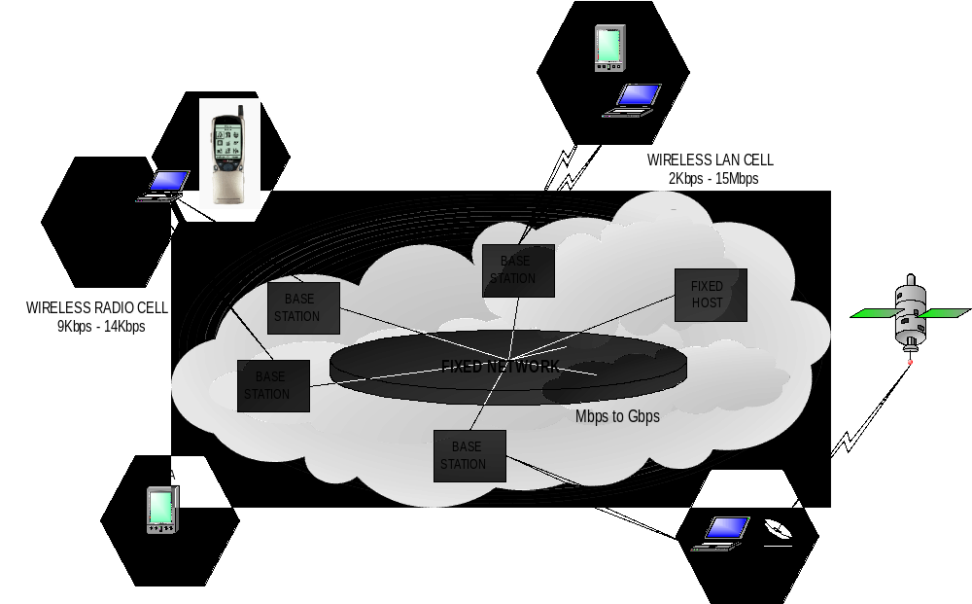
Mobile Network Architecture

Slide 15
Wireless Technologies
Wireless local area networks (WaveLan, Aironet) – Possible Transmission error, 1.2 Kbps-15 Mbps
Cellular wireless (GSM, TDMA, CDMA)– Low bandwidth, low speed, long range - Digital: 9.6-14.4 Kbps
Packet radio (Metricom) -Low bandwidth, high speed, low range and cost
Paging Networks – One way
Satellites (Inmarsat, Iridium(LEO)) – Long Latency, long range, high cost

Slide 16
Terminologies
GSM - Global System for Mobile Communication
  GSM allows eight simultaneous calls on the same radio frequency and uses narrowband TDMA. It uses time as well as frequency division.
TDMA - Time Division Multiple Access
  With TDMA, a frequency band is chopped into several channels or time slots which are then stacked into shorter time units, facilitating the sharing of a single channel by several calls
CDMA - Code Division Multiple Access
  data can be sent over multiple frequencies simultaneously, optimizing the use of available bandwidth.
  data is broken into packets, each of which are given a unique identifier, so that they can be sent out over multiple frequencies and then re-built in the correct order by the receiver.

Slide 17
Mobility Characteristics
Location changes
  location management - cost to locate is added to communication
Heterogeneity in services
  bandwidth restrictions and variability
Dynamic replication of data
  data and services follow users
Querying data - location-based responses
Security and authentication
System configuration is no longer static
Notes:
bursty network activity during connections

Slide 18
What Needs to be Reexamined?
Operating systems - TinyOS
File systems - CODA
Data-based systems – TinyDB
Communication architecture and protocols
Hardware and architecture
Real-Time, multimedia, QoS
Security
Application requirements and design
PDA design: Interfaces, Languages

Slide 19
Mobility Constraints
CPU
Power
Variable Bandwidth
Delay tolerance, but unreliable
Physical size
Constraints on peripherals and GUIs
Frequent Location changes
Security
Heterogeneity
Expensive
Frequent disconnections but predictable

Slide 20
What is Mobility?
A device that moves between
  different geographical locations
  Between different networks
A person who moves between
  different geographical locations
  different networks
  different communication devices
  different applications

Slide 21
Device Mobility
Laptop moves between Ethernet, WaveLAN and Metricom networks
  Wired and wireless network access
  Potentially continuous connectivity, but may be breaks in service
  Network address changes
  Radically different network performance on different networks
  Network interface changes
Can we achieve best of both worlds?
  Continuous connectivity of wireless access
  Performance of better networks when available

Slide 22
Mobility Means Changes
Addresses
  IP addresses
Network performance
  Bandwidth, delay, bit error rates, cost, connectivity
Network interfaces
  PPP, eth0, strip
Between applications
  Different interfaces over phone & laptop
Within applications
  Loss of bandwidth trigger change from color to B&W
Available resources
  Files, printers, displays, power, even routing

Slide 23
Bandwidth Management
Clients assumed to have weak and/or
unreliable communication capabilities
Broadcast--scalable but high latency
On-demand--less scalable and requires
more powerful client, but better response
Client caching allows bandwidth
conservation

Slide 24
Energy Management
Battery life expected to increase by only
20% in the next 10 years
Reduce the number of messages sent
Doze modes
Power aware system software
Power aware microprocessors
Indexing wireless data to reduce tuning time

Slide 25
Wireless characteristics
Variant Connectivity
  Low bandwidth and reliability
Frequent disconnections
  predictable or sudden
Asymmetric Communication
  Broadcast medium
Monetarily expensive
  Charges per connection or per message/packet
Connectivity is weak, intermittent and expensive

Slide 26
Portable Information Devices
PDAs, Personal Communicators
  Light, small and durable to be easily carried around
  dumb terminals, palmtops, wristwatch PC/Phone,
  will run on AA+ /Ni-Cd/Li-Ion batteries
  may be diskless
I/O devices: Mouse is out, Pen is in
Wireless connection to information networks
  either infrared or cellular phone
Specialized Hardware (for compression/encryption)
Notes:
Li-Ion (Lithium-Ion)

Slide 27
Portability Characteristics
Battery power restrictions
  transmit/receive, disk spinning, display, CPUs, memory consume power
Battery lifetime will see very small increase
  need energy efficient hardware (CPUs, memory) and system software
  planned disconnections - doze mode
Power consumption vs. resource utilization

Slide 28
Portability Characteristics Cont.
Resource constraints
  Mobile computers are resource poor
  Reduce program size – interpret script languages (Mobile Java?)
  Computation and communication load cannot be distributed equally
Small screen sizes
Asymmetry between static and mobile computers
Notes:
Query By Icons (QBI): Iconic visual Language [Massari&Chrysanthis95]

